Slide 1


Influenza Season in the US
Project Overview:
Objective:
Support a medical staffing agency that provides temporary healthcare workers to clinics and hospitals based on demand. This project analyzes flu trends to help identify peak seasons when staffing needs increase. The final insights will guide decisions on how to allocate resources more efficiently across different regions of the U.S.
Project Data:
• Project Brief
• Influenza Mortality Data | Source: CDC
• U.S. Population Data | Source: US Census Bureau
• Flu Visit Statistics | Source: CDC Flu View
• Pediatric Vaccination Survey | Source: CDC
Limitations:
• Data spans only from 2009 to 2017
• Mortality data reflects only one recorded cause of death, which may exclude flu-related complications
Techniques and Skills:
• Structuring a public health data project
• Validating and profiling medical datasets
• Cleaning and preparing flu-related records
• Integrating and transforming health data
• Running statistical tests and trend analysis
• Communicating insights through Tableau dashboards
TOOLS USED

Slide 2

Analytical Workflow
Reviewed data for accuracy and consistency by identifying mixed data types, missing entries, and duplicate values. Ensured the dataset was reliable before analysis.
Project Planning & Framing
Explored key statistics to identify trends and patterns in the dataset. Applied measures of central tendency and variability to detect outliers and understand distribution.
Used Excel pivot tables to organize and summarize data by categories. Helped reveal patterns across different segments and supported trend analysis.
Transformed insights into clear visuals using Excel. Results were organized and presented in PowerPoint to communicate findings effectively.
Insight Delivery & Dashboarding
Analytical Testing & Validation
Data Collection & Preparation

Slide 3
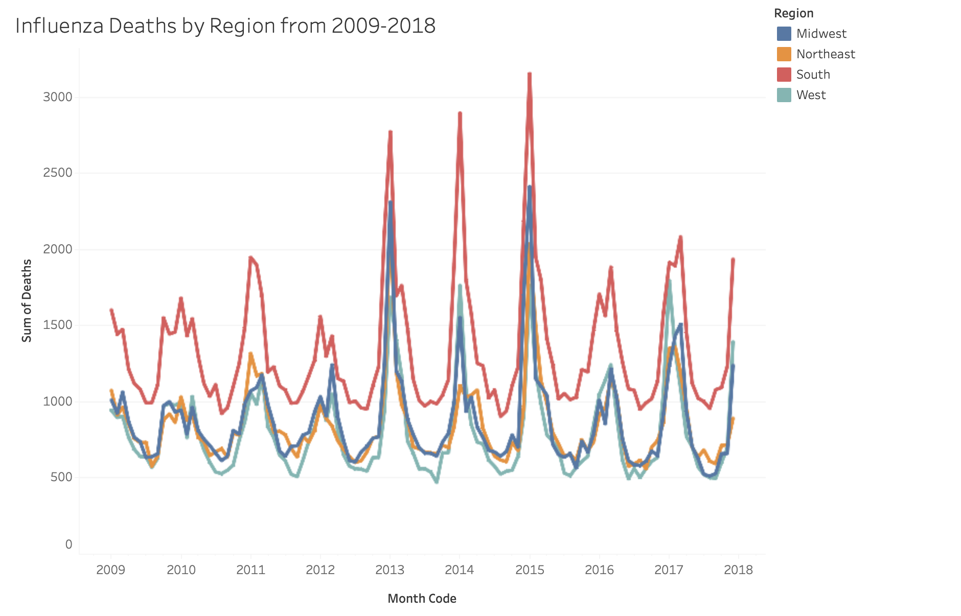
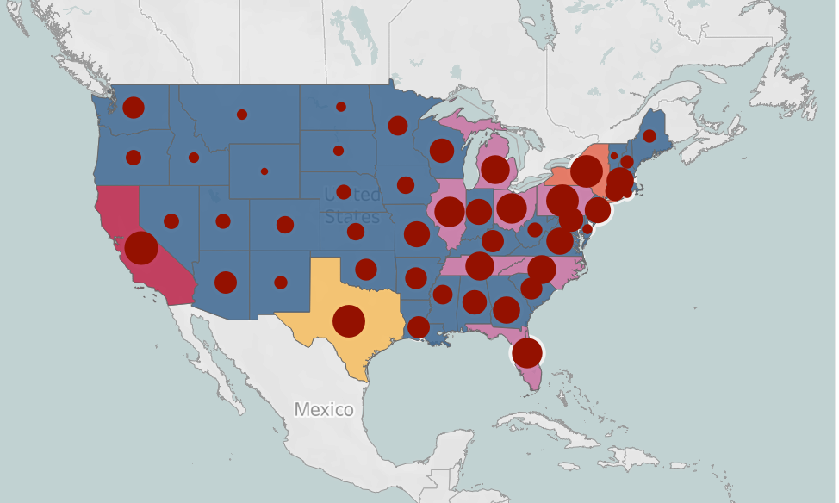
Regional and Seasonal Insights into U.S. Influenza-Related Mortality

Slide 4
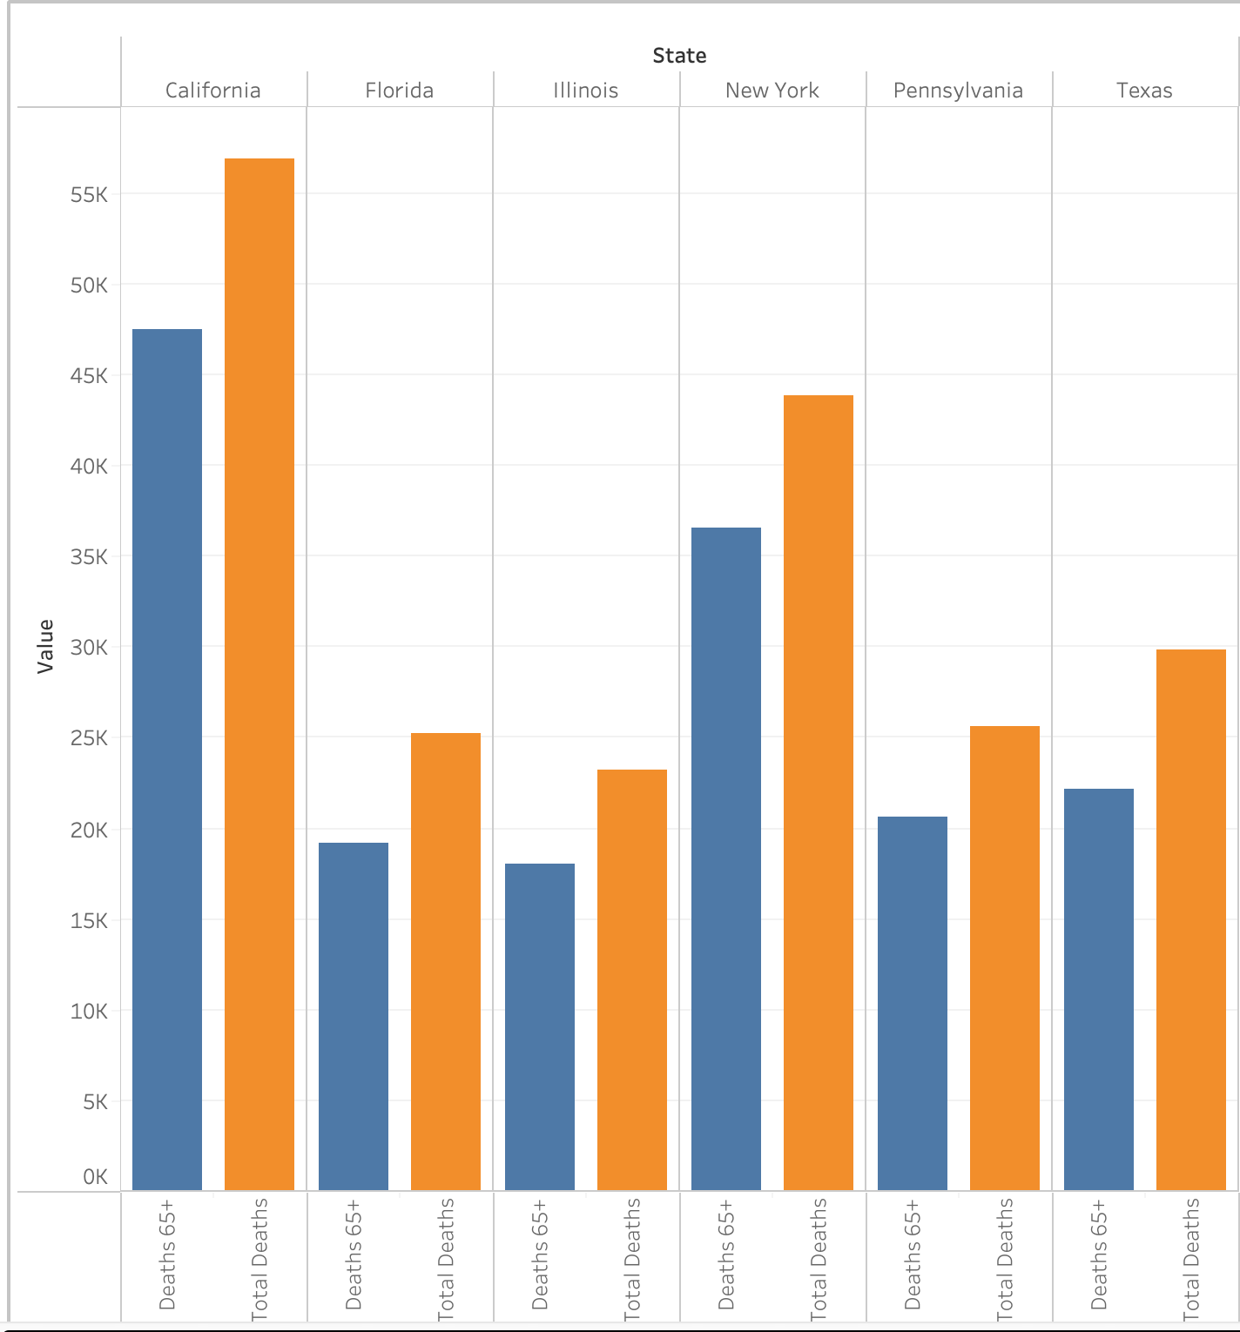
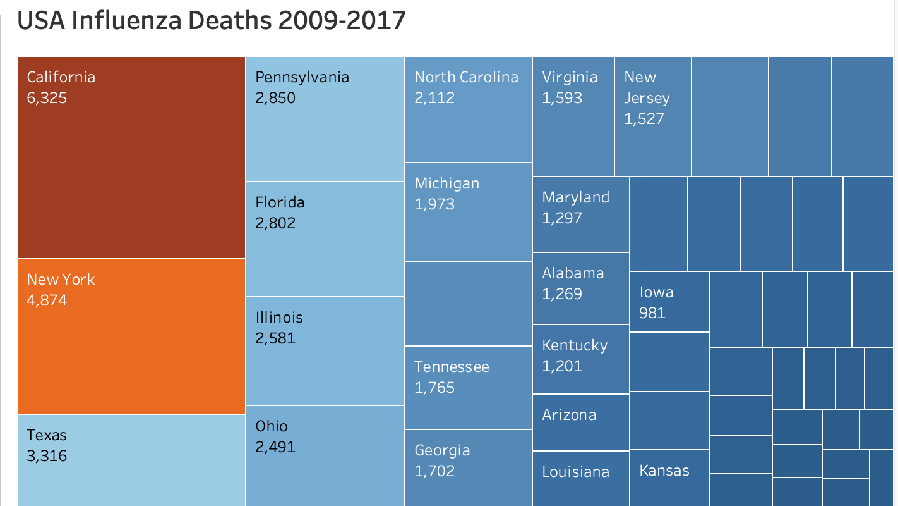
Influenza Mortality in the U.S. (2009-2017): A State-by-State Analysis
Age Group & Total Deaths Breakdown
This bar chart compares total influenza deaths vs. deaths among individuals aged 65+.
Older adults (65+) account for a significant portion of total deaths, emphasizing the need for targeted vaccinations and medical preparedness.
The highest mortality rates are observed in California, New York, and Texas, indicating states that require stronger public health interventions.
State-by-State Impact
The treemap visualizes influenza deaths by state, where darker shades indicate higher mortality rates.
California and New York lead with the most recorded deaths, followed by Texas and Florida.
States with lower case counts (e.g., Kentucky, Arizona, and Iowa) still contribute to overall mortality and require monitoring.

Slide 5

Recommendations Based on Insights
Strategic Staff Deployment:
To effectively manage the surge in influenza-related cases, medical staffing should be increased from December through February, when the peak flu season occurs. Maintaining higher staffing levels into March and April is also essential, as a secondary spike in flu-related deaths often appears during this time. Preemptive scheduling, staff cross-training, and temporary support staff can help ensure hospitals and clinics remain responsive during periods of high patient volume.
Target High-Risk States:
California, Pennsylvania, Florida, Texas, New York, and Illinois consistently reported the highest number of influenza-related deaths. These states should be prioritized for enhanced healthcare resources, vaccination programs, and public health outreach. Deploying mobile vaccination clinics and launching localized prevention campaigns can help reduce the burden in these high-risk regions.
Prioritize the 65+ Population:
Older adults remain the most vulnerable group during flu season. Establishing vaccination sites in accessible locations such as community centers, pharmacies, senior living facilities, and churches ensures seniors can easily receive their flu shots. Providing free or subsidized vaccinations, along with transportation options and educational support, can significantly increase vaccination rates and reduce mortality among the 65+ population.

Slide 6

Video Presentation

